Slide 1
Sea Level Trends from 1856 - 2015
CS-453 Data Mining Course Project Presentation by Michael Cummings

Slide 2
What is the data set?
Dataset provided by National Oceanic and Atmospheric Administration
Collection of average measurements of sea level change recorded by Center for Operational Oceanographic Products and Services stations located mostly throughout the United States
Mean 61 years of observations recorded across instances
SIZE: 142 rows, 13 columns
No missing values

Slide 3
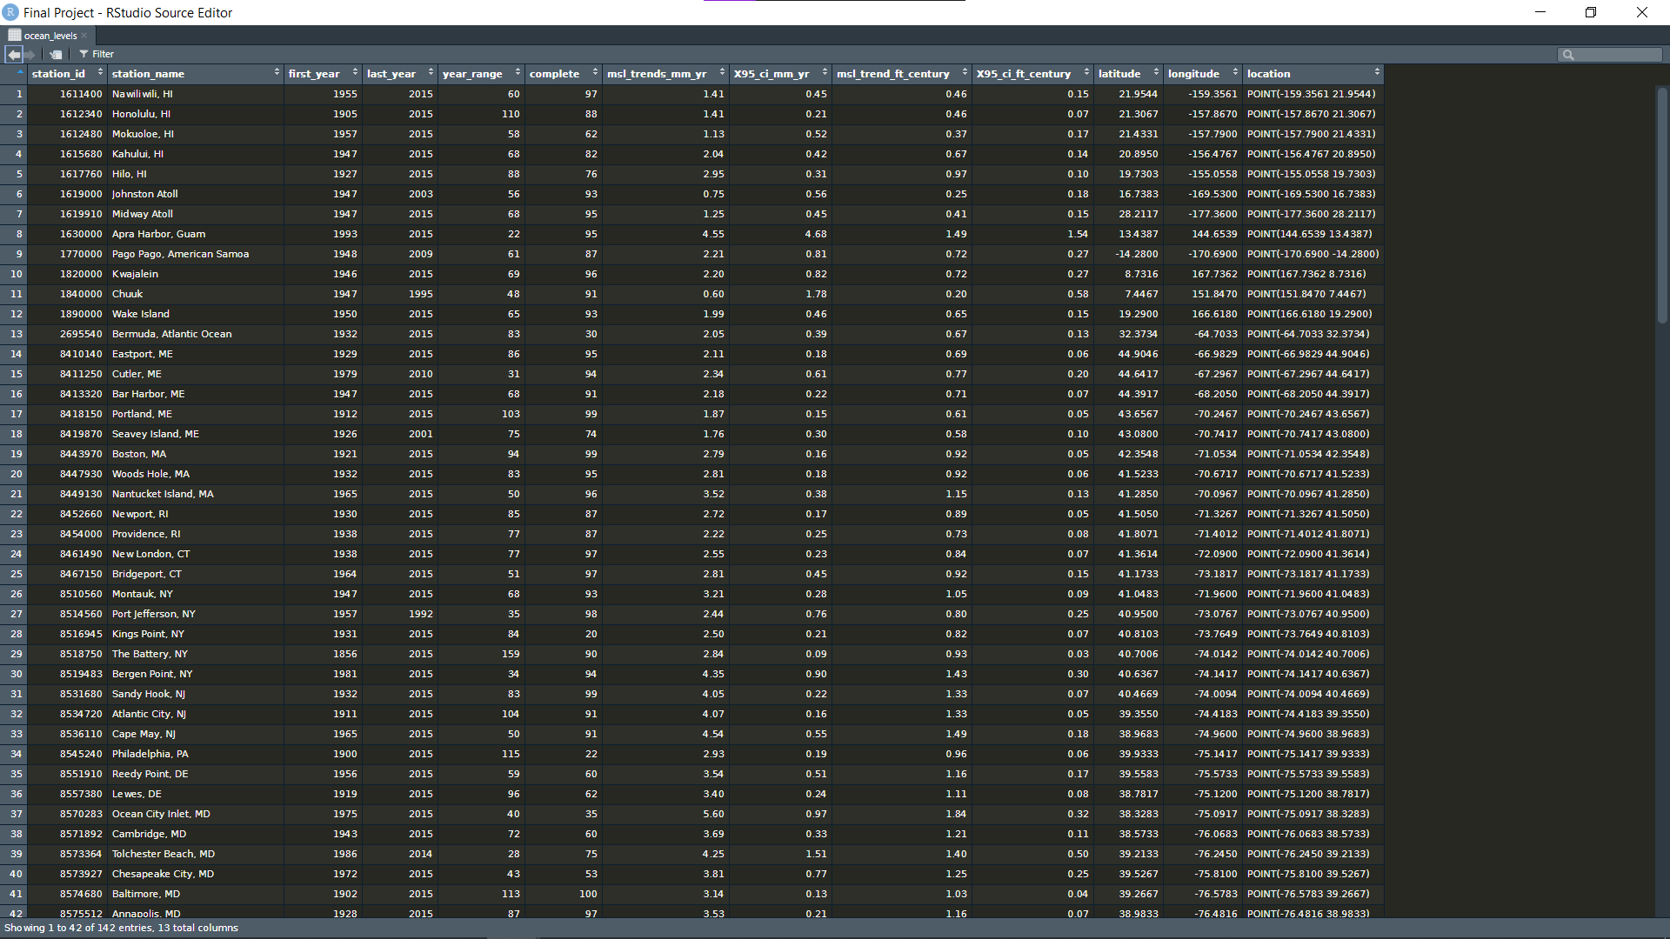
Attributes
Nominal
Station_id
Station_name
Numerical
First_year (time)
Last_year (time)
Year_range (time)
Complete (continuous)
Msl_trends_mm_yr (continuous)
X95_ci_mm_yr (continuous)
Msl_trends_ft_century (continuous)
X95_ci_ft_century (continuous)
Latitude (Geospatial)
Longitude (Geospatial)
Location Coordinate Pair (Geospatial)

Slide 4
Preprocessing Data
Removing irrelevant attributes when working in WEKA:
Station_id
Station_name
First_year
Last_year
Location

Slide 5
Preprocessing data
1. No nominal attributes – Would like to have
Solution: Mutate new nominal variables from existing values:
Is_rising (Nominal - Binary)
True or false depending on whether msl_trend_mm_yr is positive or negative
state (nominal)
Created attribute column with U.S state abbreviations for easier use with RStudio usmap package
2. Convert data frame into .csv file – working with RStudio (Visualization and Statistical Analysis)
3. Convert .csv file to .arff type (working with WEKA)

Slide 6
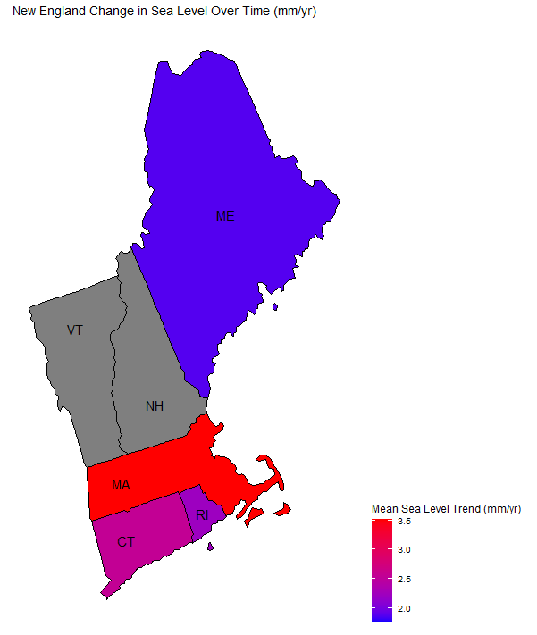
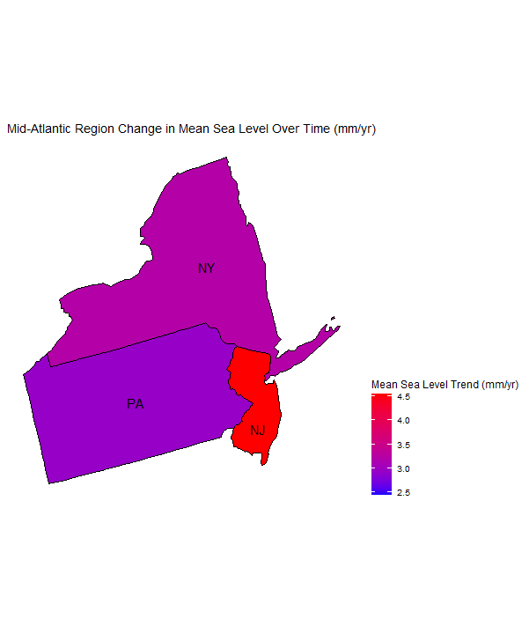
Data Visualization: New England – Mid-Atlantic
New England – Mean Sea Level Trend

Slide 7
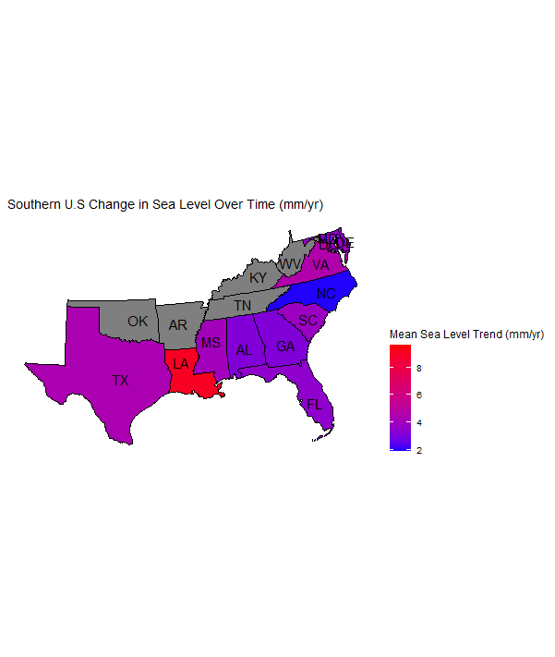
Data Visualization: Southern US

Slide 8
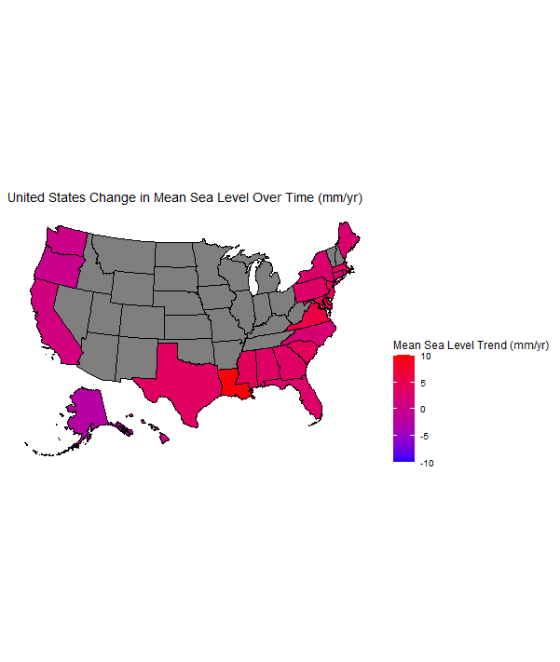
Data Visualization: US – Mean Sea Level

Slide 9
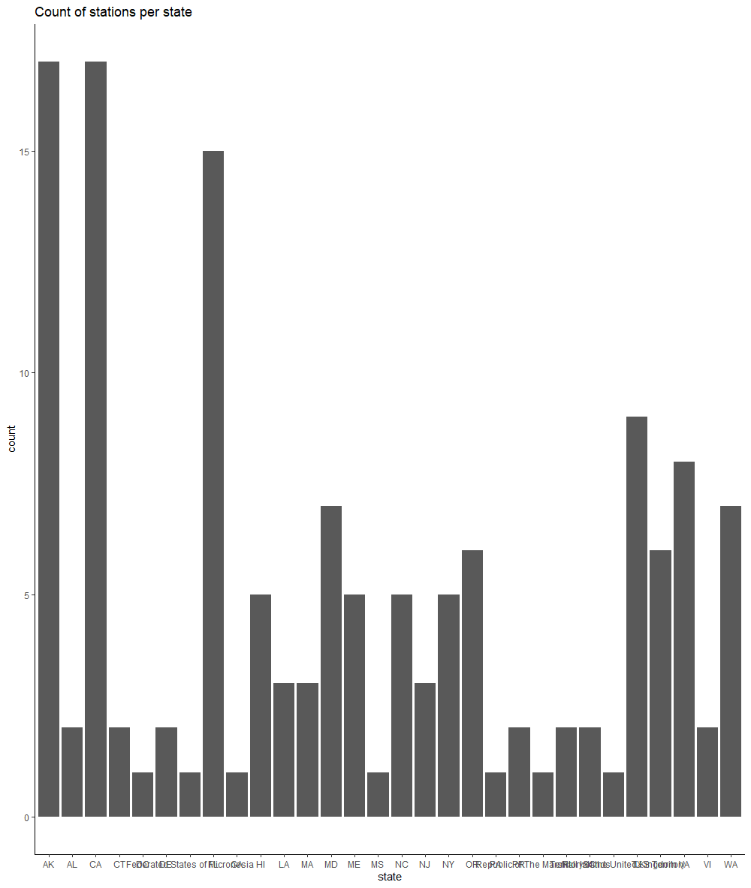
Data Viisualization: Stations per State

Slide 10
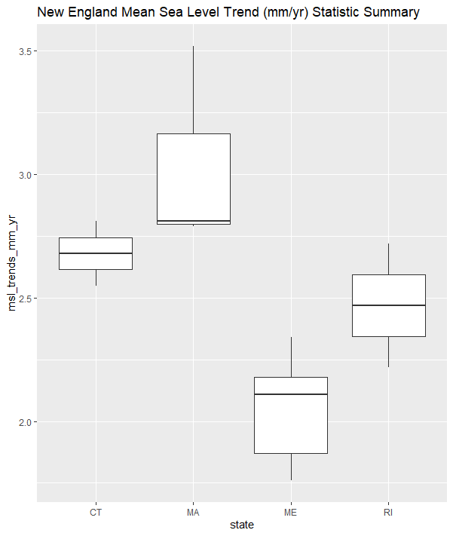
Statistical Analysis: Mean Sea Level – New England

Slide 11
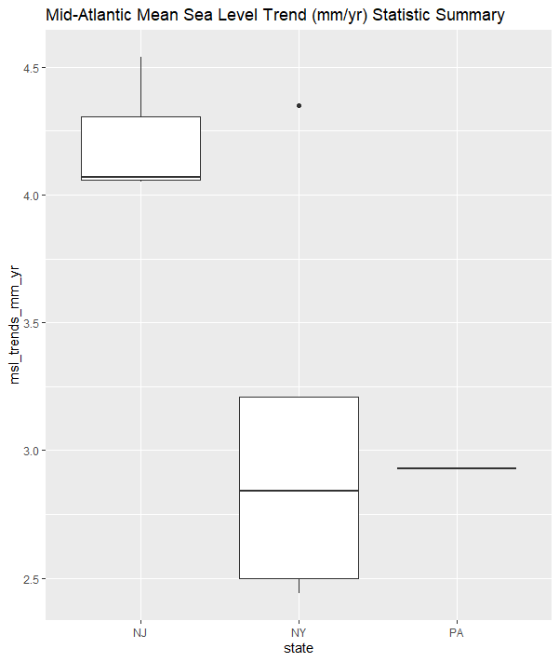
Statistical Analysis: Mean Sea Level – Mid Atlantic

Slide 12
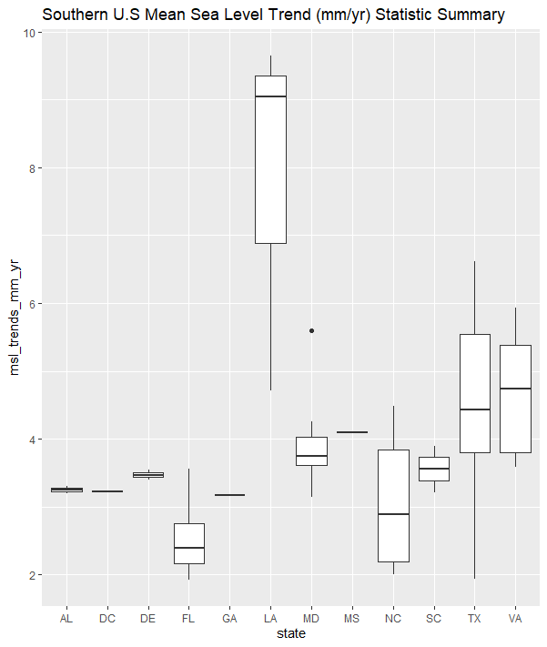
Statistical Analysis: Mean Sea Level – Southern US

Slide 13
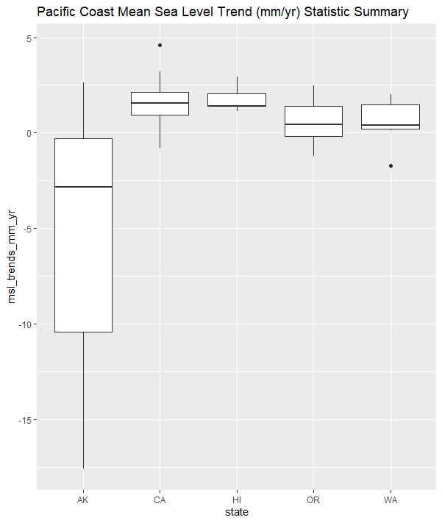
Statistical Analysis: Mean Sea Level – Pacific Coast

Slide 14
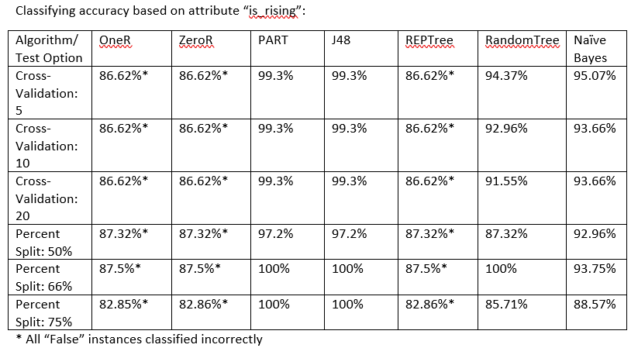
1. Classification: “Predict is_rising”

Slide 15
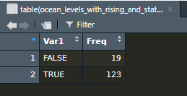
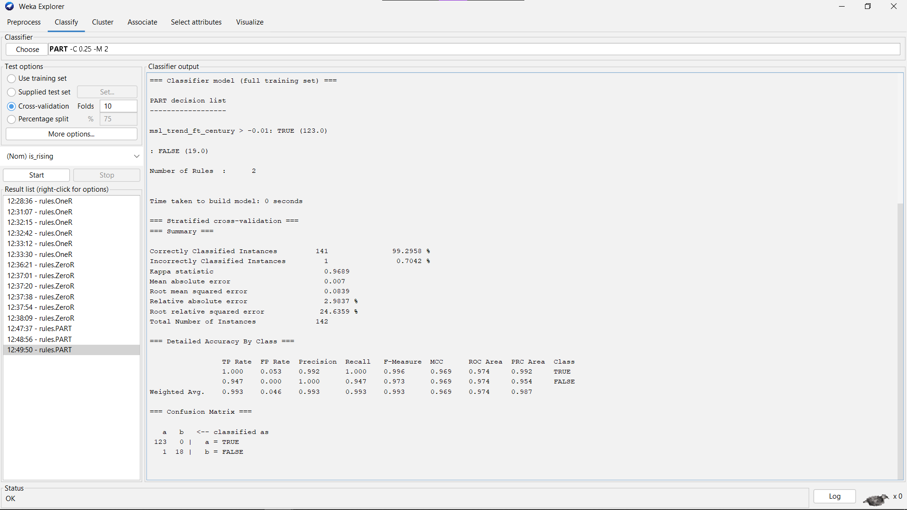
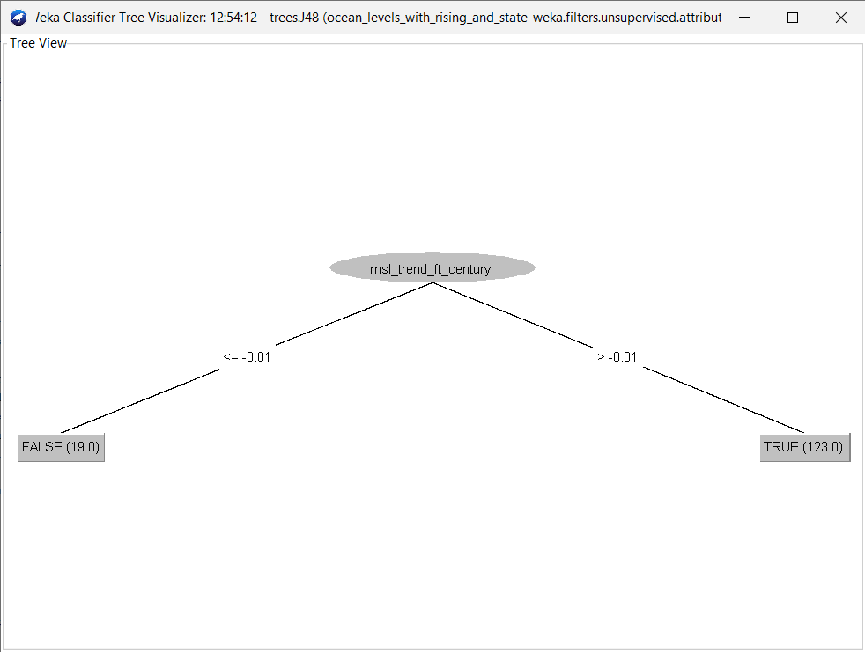

Slide 16
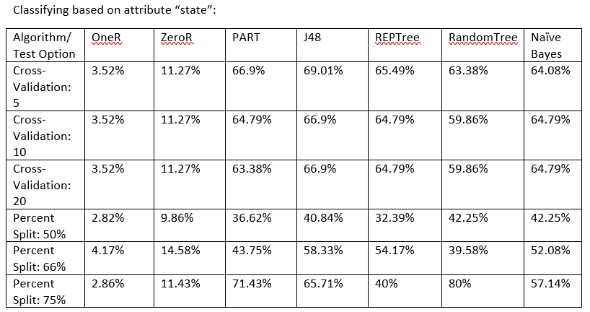
2. Classification: “Predict State”

Slide 17
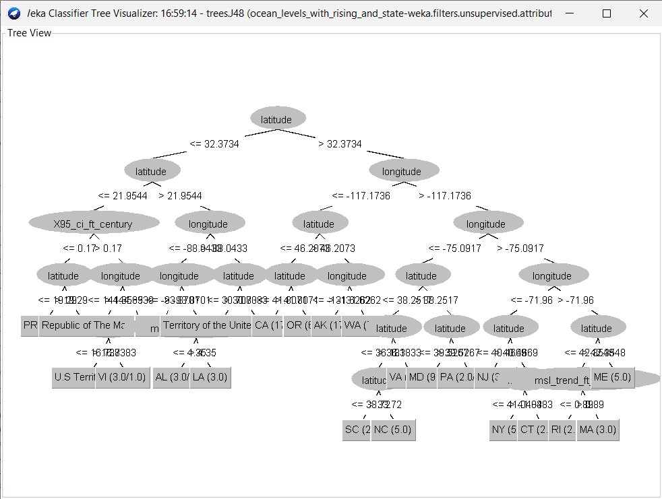

Slide 18
Conclusions
Rules algorithms had higher instances of accuracy, but some arbitrarily assigned all instances to “True”, which isn’t helpful
OneR and ZeroR unsuitable for classification on either attribute
REPTree unsuitable for “is_rising”, but had reasonable accuracy classifying by “state”
PART very accurate classifying by “is_rising”, somewhat accurate classifying by state
J48 and RandomTree performed very well on the logical attribute is_rising, but less effective classifying by state

Slide 19
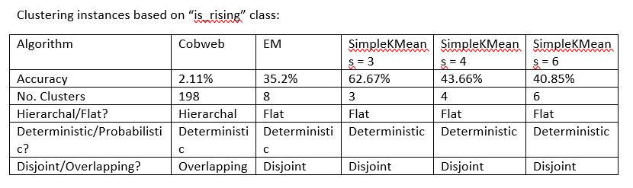
3. Clustering: Cluster the data with respect to is_rising

Slide 20
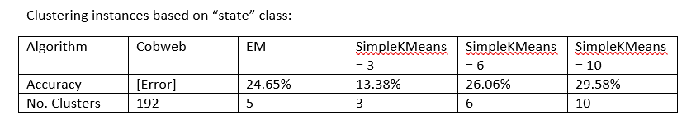
4. Clustering: Cluster the data based on state

Slide 21
Conclusion
Can we cluster together instances depending on whether they have an average rise or fall in sea level?
Not accurately
Can we cluster together instances based on their state?
WEKA tools do not perform this task accurately

Slide 22
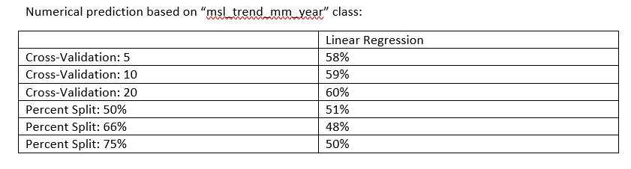
5. Numerical Prediction: “Can we predict msl_trend_mm_year?”

Slide 23
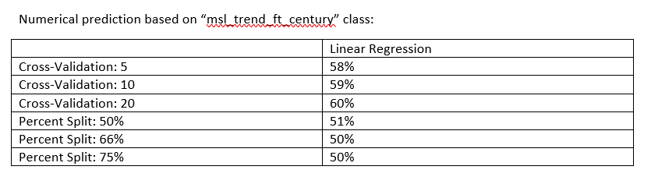
6. Numerical Prediction: “Can we predict msl_trend_ft_century?”

Slide 24
Conclusion
Can we predict future sea level trends with WEKA tools?
Not accurately, only 50% - 60% accurate
Data set may not have enough information to inform an accurate prediction; msl_trend columns are averages over decades, after already being averaged by month

Slide 25
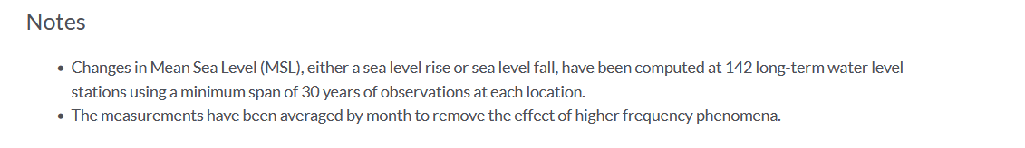
Limitations
Data mostly collected around the contiguous United States, can’t provide any information on trends in sea level elsewhere in the world
Newest data collected is from 2015
Msl_trend attributes are averages taken across 30+ years, after already having been averaged by month
Notes:
Source: https://data.world/noaa/sea-level-trends

Slide 26
Sources
Dataset:
https://data.world/noaa/sea-level-trends
Tools:
Weka
RStudio
tidyverse(ggplot2, stringr, dplyr)
usmap https://cran.r-project.org/web/packages/usmap/vignettes/mapping.html

Slide 27
Helpful Websites
https://www.marsja.se/r-add-column-to-dataframe-based-on-other-columns-conditions-dplyr/
https://cran.r-project.org/doc/manuals/r-release/R-intro.pdf
https://evoldyn.gitlab.io/evomics-2018/ref-sheets/R_strings.pdf
https://datacamp-community-prod.s3.amazonaws.com/c1fae72f-d2d7-4646-9dce-dd0f8fb5c5e8
https://www.bls.gov/respondents/mwr/electronic-data-interchange/appendix-d-usps-state-abbreviations-and-fips-codes.htm

